Slide 1
ML at Scale using Kubernetes Jayant Thomas (JT)

Slide 2
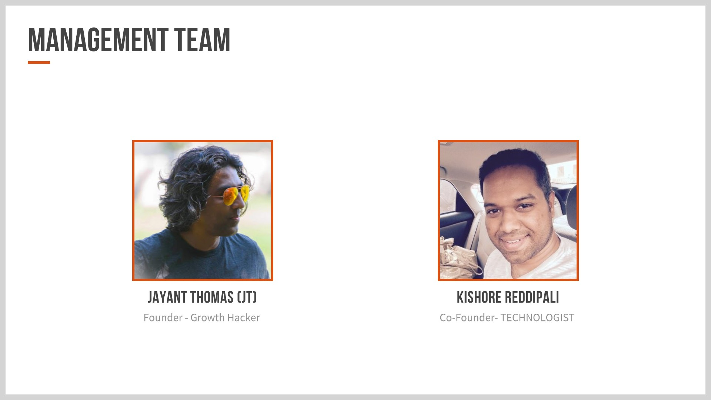

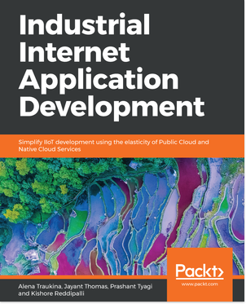
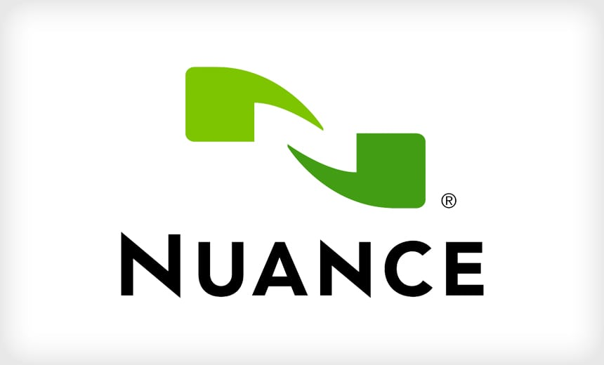

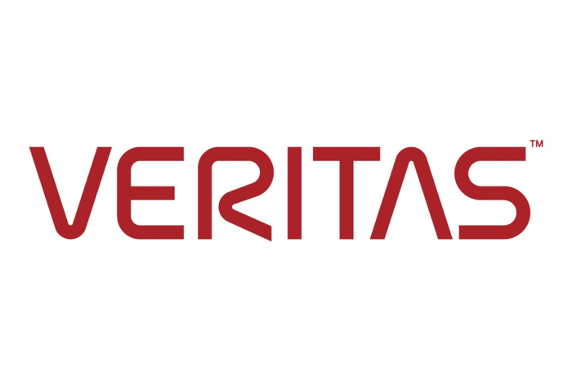


IoT Development Top Seller
Head of Machine Learning & AI
Veritas
https://www.linkedin.com/in/jayantthomas/

Slide 3
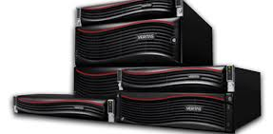
Who are we ?

Slide 4









Veritas #1 in Data Protection
#1 Archive and Backup and Recovery Software Market Share
15 Years Of Data Protection Magic Quadrant Leadership
#1
Integrated Backup Appliance Market Share
#1
Software Defined Storage Management Market Share
#1
Integrated Backup Appliance Market Share
#1
Software Defined Storage Management Market Share
Recognized Leadership
Gartner, Inc., Market Share: Enterprise Infrastructure Software, Worldwide, 2017, May 2018
IDC Quarterly Purpose Built Backup Appliance Tracker, June 28, 2018
Gartner, Inc., Magic Quadrant for Data Center Backup and Recovery Solutions, July 31, 2017
Notes:
Veritas continues to maintain a dominant position in the data protection and the software defined storage market.
Veritas has been recognized as the leader in the Gartner Data Protection Magic Quadrant for 15 years in a row.
Veritas has also the highest market share in:
Archive and Backup and Recovery Software
Software Defined Storage Management
Integrated Backup Appliance
These are the 2 key areas we’ll be exploring today as we look at the customer case sstudy

Slide 5
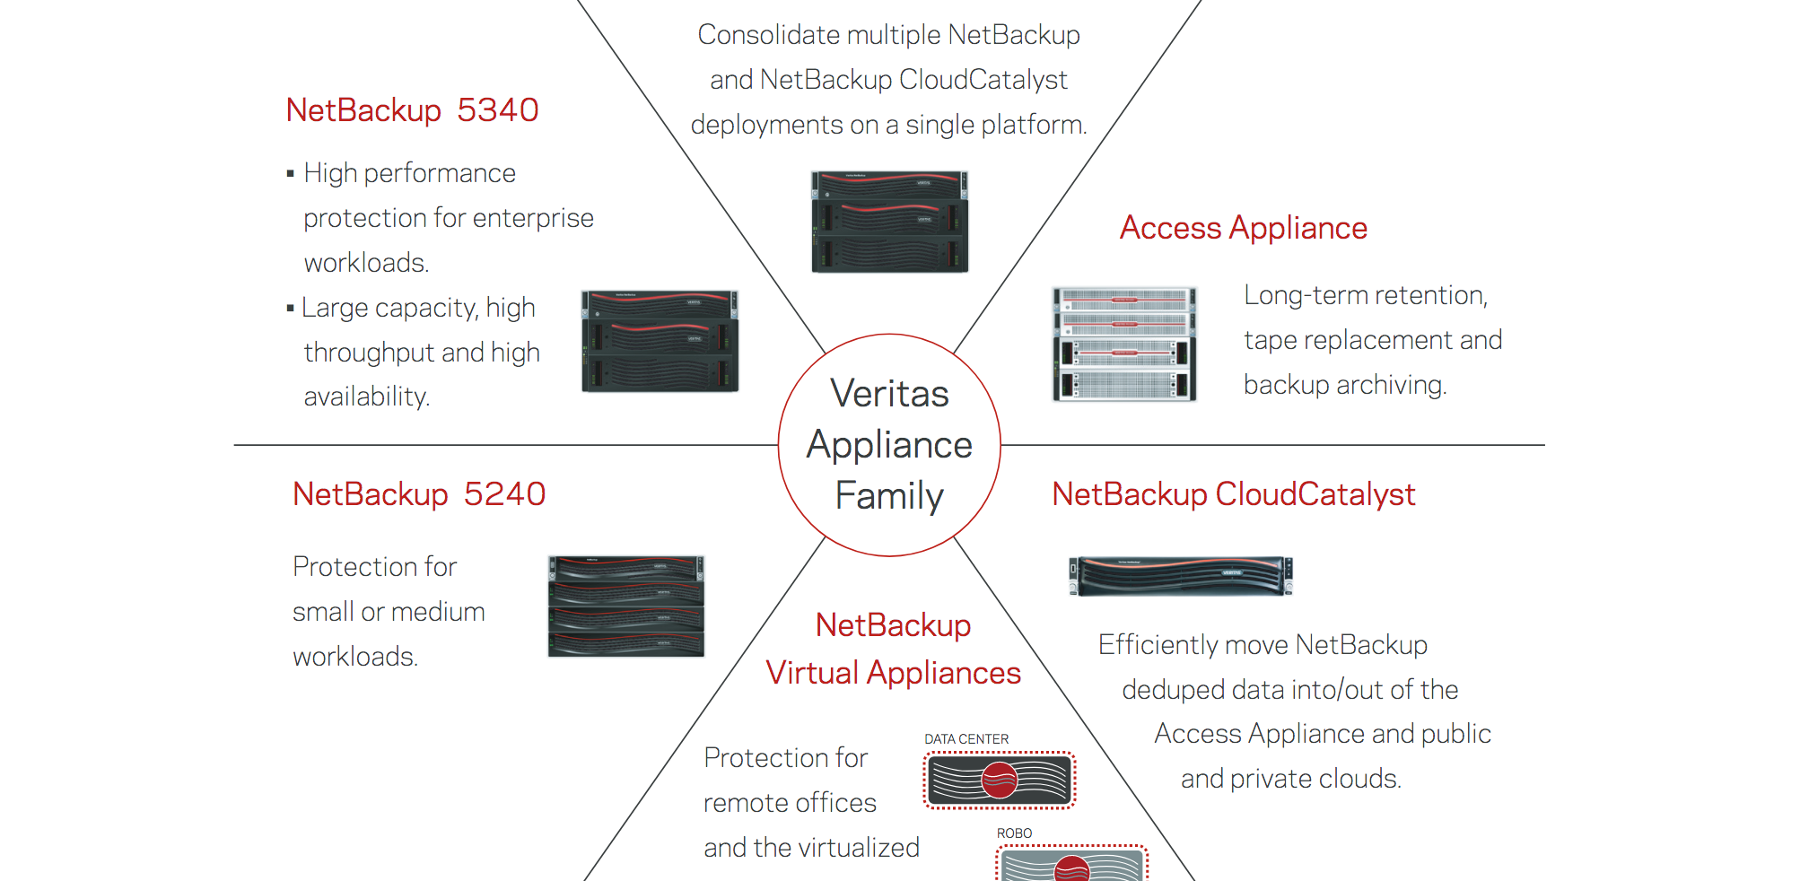
Netbackup Appliances
More than 250K appliances sold and deployed over the globe
5 different types of appliances
Backups different types of workloads
Scales from 2TB to 30PB
Systems Monitored by Veritas

Slide 6
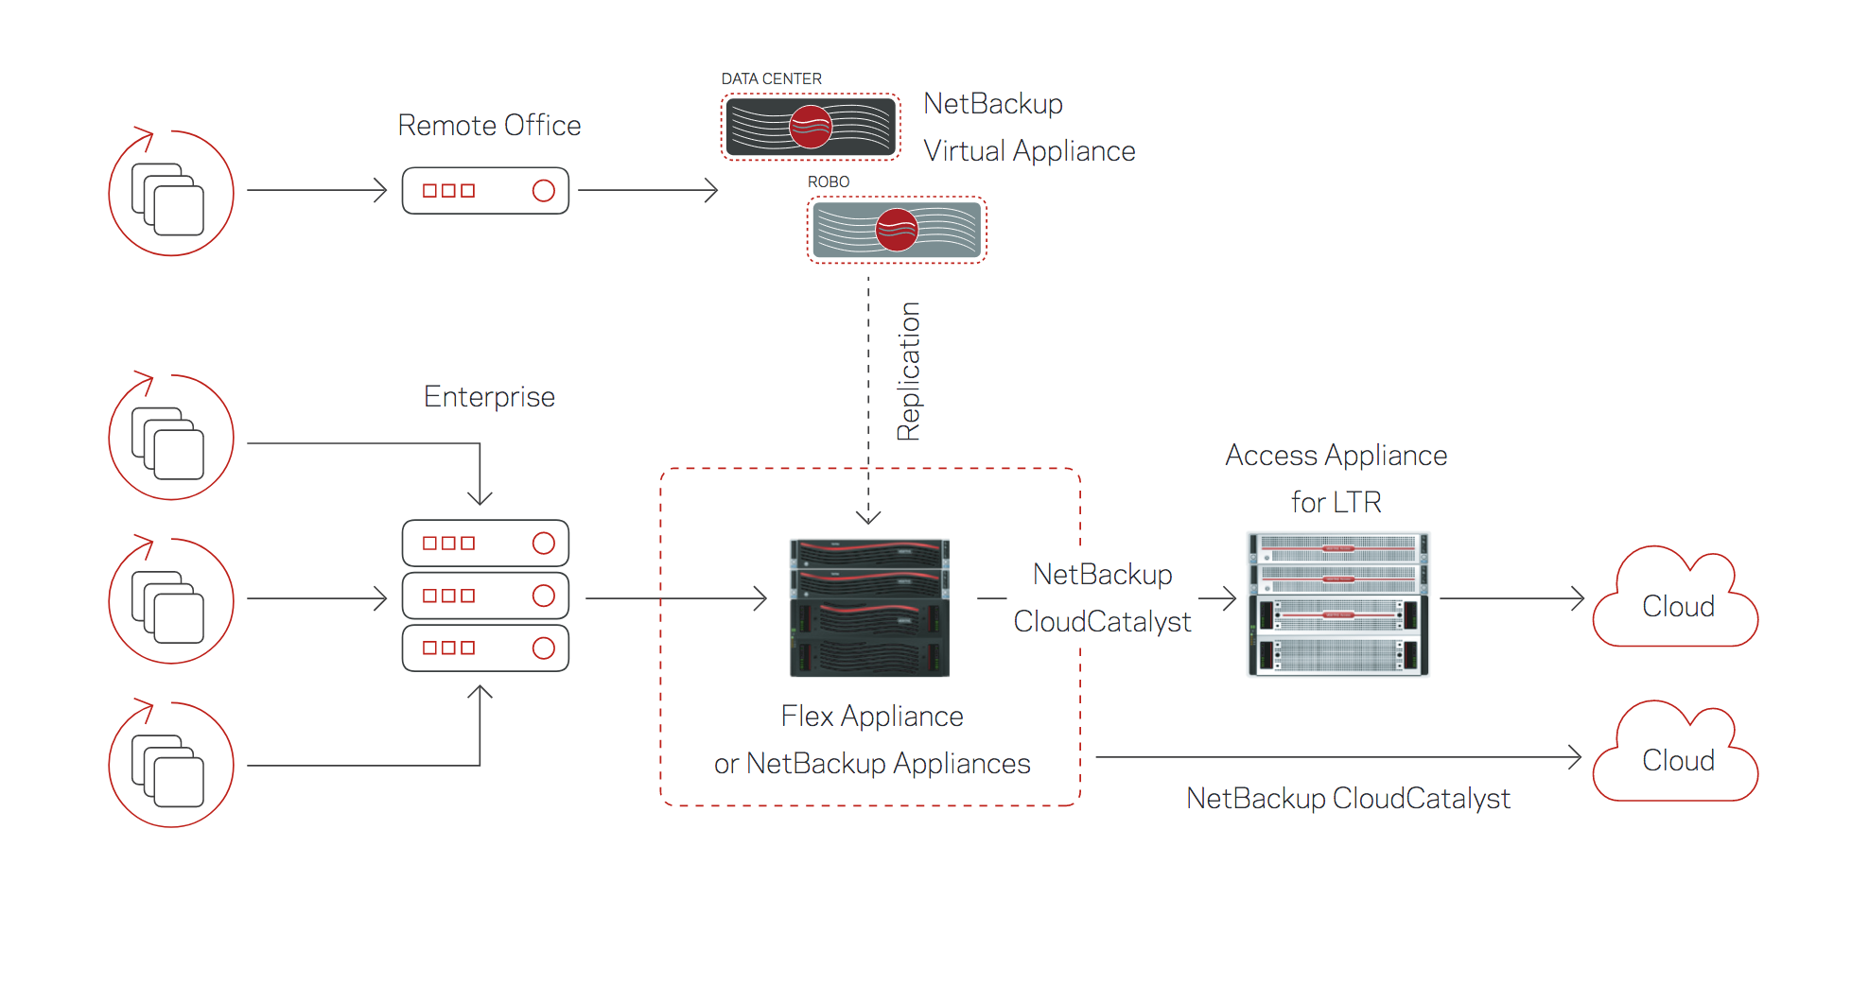
Netbackup Appliance Functionality

Slide 7
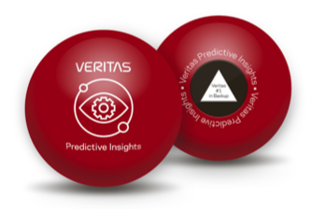
Machine Learning at Scale

Slide 8
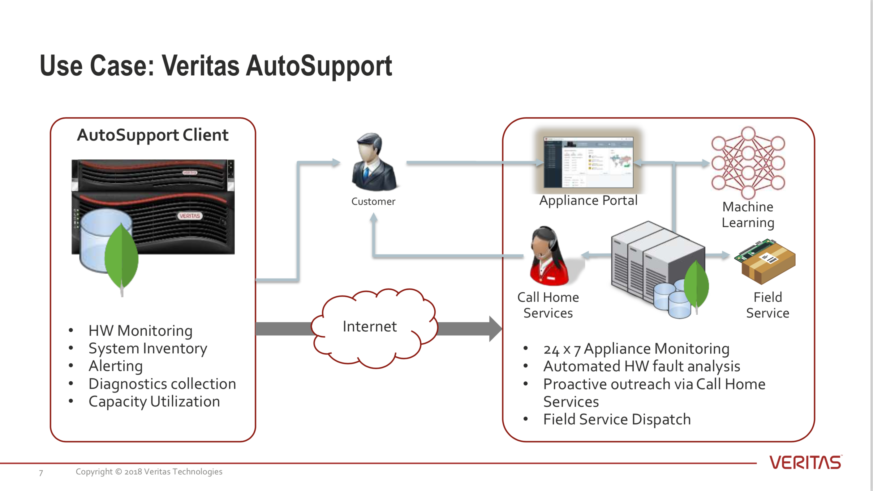

Slide 9



The Evolving Support Experience
Reactive
Proactive & Prescriptive
Streamlined Support Experience
9
Notes:
Rear view mirror way of resolving issues after they have occurred has changed to a more proactive and prescriptive approach.

Slide 10




Introducing Veritas Predictive Insights
Maintenance Insights
Resource Insights
Support Insights
AI/ML Based Predictive Analytics
Bring the Power of AIOPS to your Infrastructure
Notes:
According to Gartner:. AIOps platforms are software systems that combine big data and artificial intelligence (AI) or machine learning functionality to enhance and partially replace a broad range of IT Operations processes and tasks, including availability and performance monitoring, event correlation and analysis, IT service management, and automation.)
Veritas Predictive Insights (Pi) is is a SaaS platform that utilizes Artificial Intelligence (AI), and Machine Learning (ML), to deliver proactive support services for both new and existing Veritas appliance customers.
It delivers:
Maintenance Insights
Resource Insights
Support Insights

Slide 11





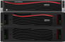


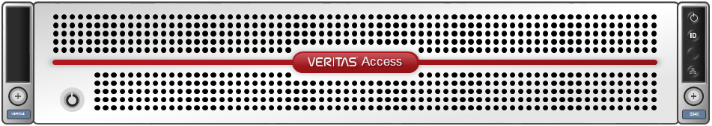

Veritas Predictive Insights
Always-On Data Sources
System Reliability Score
Recommendation Engine
Capacity Consumption
Telemetry
Appliance Health Prediction
Job Failure Remediation
Firmware
78
Patches
Support
Events
Domain Optimization
Resource Optimization
Recommended
Actions
AutoSupport
Configuration
Continuous Learning
Environmental
Evidence
Components
Performance Optimization
Storage Forecasting
Veritas AI/ML Insights Engine
Notes:
Veritas Predictive Intelligence delivers “Always On” service with Intelligent, Data Driven Decisions and Optimized Services covering:
Maintenance Insights: Understand & improve the health of your appliance. It ensure your infrastructure delivers the best performance.
Resource Insights: Optimize your existing infrastructure & accurately forecast your future requirements. Ensures that you reduce the overall TCO and get the most from your IT budget by avoiding over-provisioning and ensuring the best ROI.
Information Insights: Ensure that you reduce the risk to your organization and meet your compliance and regulatory requirements in a simple and easy to handle manner with better classification, risk management, policy optimization and file remediation.
Support Insights: 24x7 proactive monitoring, alerting and faster time to resolution ensure that unplanned outages and downtimes are minimized.

Slide 12
ML Platform Overview

Slide 13
Why Kubernetes ?
Container platform
Microservices platform
Portable cloud platform
Application-centric management
Auto-scalable infrastructure
Notes:
Environment consistency across development testing and production
Loosely coupled infrastructure, where each component can act as a separate unit
Higher density of resource utilization
Predictable infrastructure which is going to be created

Slide 14
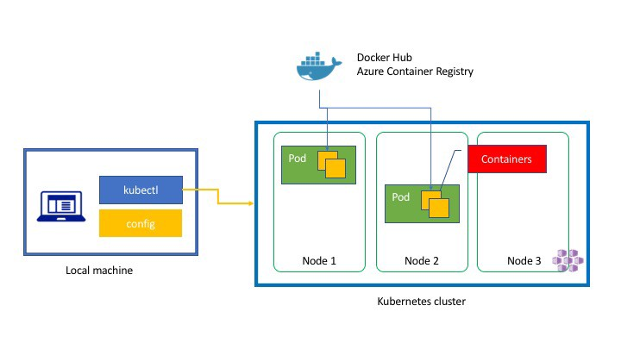
Kubernetes Architecture

Slide 15
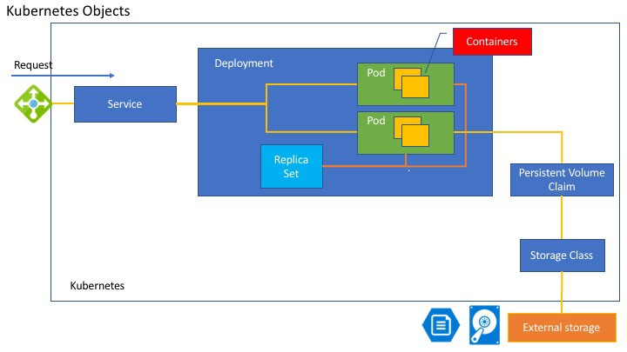
Notes:
apiVersion: apps/v1beta1 kind: Deployment metadata: name: azure-vote-back spec: replicas: 1 template: metadata: labels: app: azure-vote-back spec: containers: - name: azure-vote-back image: redis ports: - containerPort: 6379 name: redis --- apiVersion: v1 kind: Service metadata: name: azure-vote-back spec: ports: - port: 6379 selector: app: azure-vote-back --- apiVersion: apps/v1beta1 kind: Deployment metadata: name: azure-vote-front spec: replicas: 1 template: metadata: labels: app: azure-vote-front spec: containers: - name: azure-vote-front image: microsoft/azure-vote-front:v1 ports: - containerPort: 80 env: - name: REDIS value: "azure-vote-back" --- apiVersion: v1 kind: Service metadata: name: azure-vote-front spec: type: LoadBalancer ports: - port: 80 selector: app: azure-vote-front

Slide 16
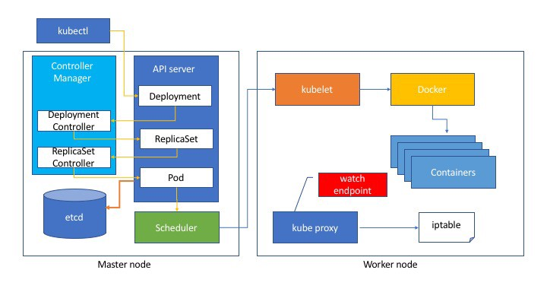

Slide 17
ML Platform using Kubernetes
Registry
Scheduler
Workflow
ML Algo
ML Algo
ML Algo
ML Algo
ML Algo2
ML Algo

Slide 18
ML Runtime on Kubernetes
Registry
Airflow Workflow
ARGO Workflow
ML Algo
ML Algo
ML Algo
ML Algo
ML Algo2
ML Algo
Arango & Influx DB
Audit

Slide 19
ML Runtime on Kubernetes
Registry
External API
Kubernetes Cluster
Airflow Workflow
ARGO Workflow
ML Algo
ML Algo
ML Algo
ML Algo
ML Algo2
ML Algo
Arango & Influx DB
Audit

Slide 20
What Problem it solved ?
Reliability
Dynamic Scaling
Building Pipelines easily by chaining many different algorithms
State management was easy with NoSQL DB providing the scalability
Easily Persist data into DB and access the data in the next workflow task

Slide 21
Veritas Predictive Insights Deployment
User Interface
Management Services
Container Infrastructure
Prophecy Platform
DAL + DS
Advisor
Miner
Miner
Advisor
WKFL
Document + TSDB
Pod1
Pod2
Pod5
PodN
Workflow + Pipelines
Compute Farm
Scale accordingly to workload needs
Kube Node1
Kube Node2
Kube Node3
Kube NodeN
IaaS (Cloud)
AWS Cloud
Telemetry Data Source

Slide 22
Experiences and Lessons Learned

Slide 23
Why Argo and Airflow?
Airflow does the overall scheduling of the algorithms + Tasks
Invokes Argo to run that specific Tasks or Algorithm on Kubernetes
Airflow uses python extensions to invoke Argo
argo submit -f workflow.yaml

Slide 24
How does Airflow knows when to schedule?
Based on events from the appliances
We use a custom Airflow Journal that does Journal driven builder which schedules the airflow dags and tasks.
from wfmgr.airflow_adapter import WorkflowDef, PoolDef
from wfmgr.miner_builder import MinerBuilder
from airflow import DAG
slots = int("1")
reserve = int("1")
template_types = "RecommendKmeans"
miner_dag, run_miner = MinerBuilder(wf_def=WorkflowDef(name="recommend_kmeans",
schedule="0 */3* * *", pool_def=PoolDef(slots, reserve)),
template_args={
"template_types": [x.strip() for x in template_types.split(",")]}).miner_dag()

Slide 25
Challenges #1 Issue with network provider
Flannel is used as a network provider and it does not clear the pod ips used
Work around is to use a script that periodically cleans up the pod ip’s
Default 50M max memory allocation was not sufficient for Flannel need to be increased

Slide 26
Challenges #2 Issues with frequent start and stop of pods
Starting and stopping a pod is an expensive operation. ~30 sec
It is inefficient to start and stop pods if the tasks runtime less than the creation time
Solution is to batch up more operations together

Slide 27
Challenges #3 Issues Airflow scheduling lags
Airflow lags between 2 consecutive scheduled tasks can be few minutes
Workaround is to batch journal entries in a given task to work around this challenge

Slide 28
Challenges #4 Issues Arango DB
We are running into issues with Arango DB cluster setup
Frequent restarts needs to be handled by monitoring scripts

Slide 29
Audit Logs
Keep track of all the jobs are run
How long they took
If they are successful
Capture any errors
Captures output
REST API for accessing the audit logs

Slide 30
Veritas Predictive Insight in action

Slide 31
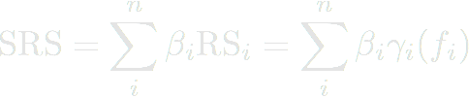
System Reliability Score (SRS)
Config Drifts
Active, Predictive Faults
Storage Forecast
Dedup Anomaly
Predictive Events
...
Model-N
+
+
+
+
+
+
RS1 [0-100] + Evidence
RS2 [0-100] + Evidence
RS3 [0-100] + Evidence
RS4 [0-100] + Evidence
RS5 [0-100] + Evidence
RS-N [0-100] + Evidence
Reliability Score + Evidence backing the score

Slide 32
Recommendations – Flow, Feedback, Learning
Auto-Support
UI
Cleansing, filtering, learning
Storage
Forecast
Thermal Anomaly
Filtering
&
Prioritization
Suggested
Recommendations
Management Services Layer
Recommendation
Advisors
Manual
Recommendation
Survival
Analysis
Appliance
Specific
Recommendations
Configuration
Drift
Naïve
Probability
Capture Tribal Knowledge
Feedback
Learn, Correct, Adjust on feedback

Slide 33
Storage Usage Forecast
Time | System | Log | Share | Advanced Disk | MSDP | MSDP Catalog | NBU Catalog | Config
2016-04-11T17:34:55.37602 | 14.0 | 15.00415 | 0.0 | 947.537800 | 6312.08 | 1.66180 | 0.0 | 21.13150
2016-04-11T17:49:51.58820 | 18.0 | 15.01245 | 0.0 | 947.542024 | 6312.14 | 1.66230 | 0.0 | 21.36500
Params: {
Appliance ID,
Storage Pools,
...
}
Storage Usage Reliability Score
Reliability Score [0-100]
+
Evidence
Storage Forecast Algorithm
Forecast Data
Weighting
Constraints
Time | System | Log | Share | Advanced Disk | MSDP | MSDP Catalog | NBU Catalog | Config
2016-04-12 | 19.0 | 15.01345 | 0.0 | 947.5300 | 6312.16 | 1.66380 | 0.0 | 21.456
2016-04-13 | 20.5 | 15.01456 | 0.0 | 947.5424 | 6312.18 | 1.66430 | 0.0 | 21.635

Slide 34
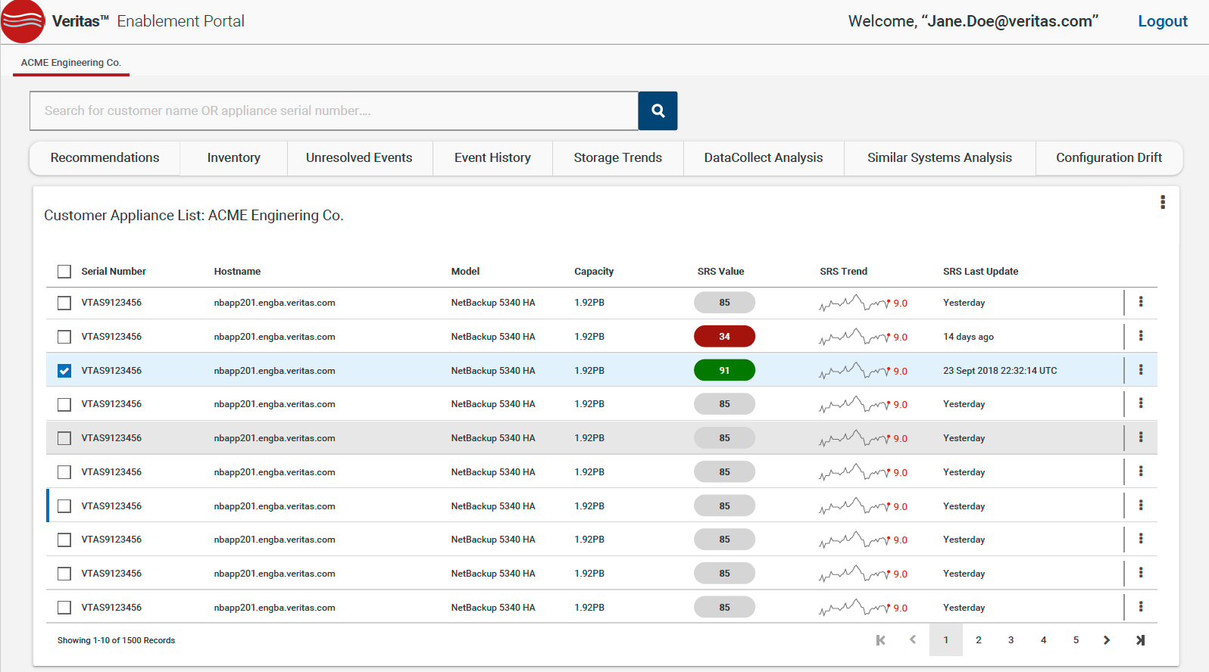

Slide 35
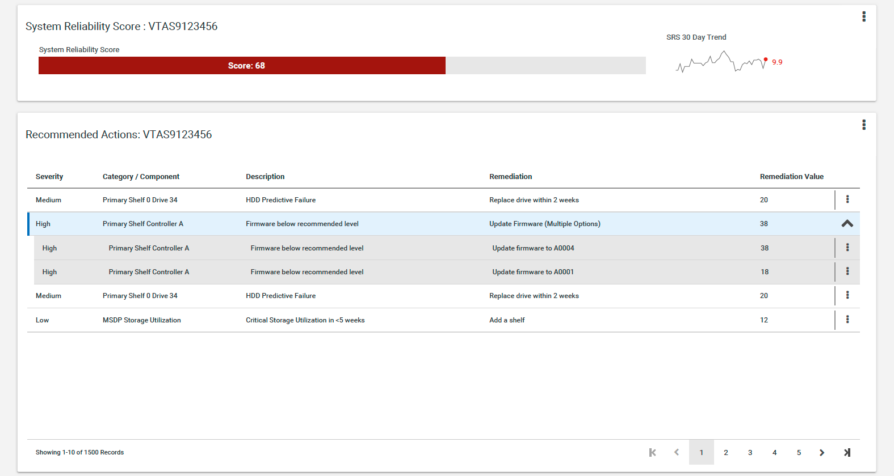

Slide 36
